Slide 1
DWCE EBENEZAR STATUS
The journey from 2023 to 12th March 2025 Tr Caring Carol

Slide 2
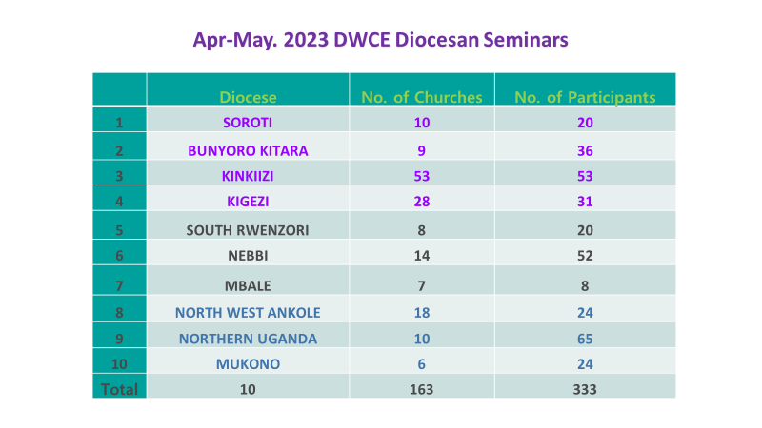
DWCE EBENEZAR STATUS
The journey from 2022 -2025

Slide 3
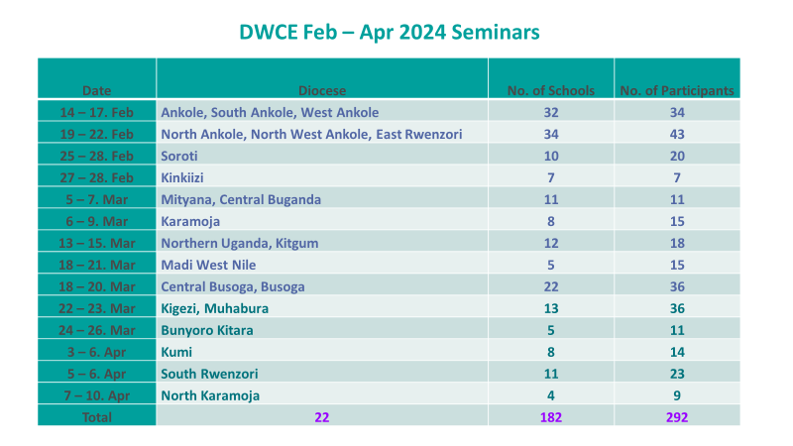
DWCE EBENEZAR STATUS
The journey from 2022 -2025

Slide 4
DWCE EBENEZAR STATUS
Date | Diocese/ Archdeaconries | No of Schools/ Churches | No of Participants
6-8 June | West Ankole | 23/ 10 Arch | 42
13-15 June | Lango | 13 schs | 28
16-18 June | Sebei | 59 | 98
7 – 9 July | Nebbi | 30 | 30
12 – 13 July | North Mbale | 7 | 14
18 – 19 July | Mukono | 23 | 23
2nd Aug | Kampala | 16/6 | 33
 | Northern Uganda | 6 Churches | 12
14th – 15th October | Mityana | 10/12 | 22
22nd October | North Ankole | 25 | 25
Nov 2024 | Kampala ( Nakasero P/S | 1 | 12
Nov 2024 | Bwera SS | 1 | 80
Dec 2024 | Northern Uganda | 1 | 38
The journey from 2022 -2025

Slide 5
2024 Total Participants
1,082 Dream drivers ( 29 Dioceses)

Slide 6
DWCE Drivers Training
27th – 30th August ( 54) teachers PARTICIPATED

Slide 7
Coaches’ Refresher Seminar
4^{th – 7th Sept} ( 24 ) participated

Slide 8
DWCE EBENEZAR STATUS
Date | Diocese/ Archdeaconries | No of Schools/ Churches | No of Participants
23rd -24th January 2025 | North West Ankole |  | 43
 | South Rwenzori / Kinyaseke Archdeaconry (SS2) | 2 Parishes | 85
10th -16th Feb | Butembo Diocese (Congo) / Archdeaconries | 7 | 35
14th - 15th Feb | West Buganda Diocese / Kabungo Archdeaconry | 4 Parishes | 42
2024 | Consolidated ( West Ankole ) | 23 schools / 10 Archdeaconries | 107
1^{st – 22nd Feb} | Luwero Diocese/ Archdeaconries | 7 Parishes | 106
21st Feb | Namirembe ( Vision Cast) | Schools | 123
28th Feb | North Ankole | 29 Parishes | 29
10th – 11th March | Masindi Kitara | 5/7 | 19
13th March | Northern Uganda ( Gulu Primary) | 1 | 31
14th & 22nd March | South Rwenzori ( Kiswa, Buyisumbu) | 2 Parishes | 36
The journey from 2022 -2025
Notes:
Jesus started with 12; how much more can we do with such a number?

Slide 9
DWCE EBENEZAR STATUS
Date | Diocese/ Archdeaconries | No of Schools/ Churches | No of Participants
Feb & March | Nebbi / Ukuru, Goli Central& Urban | 24 parishes | 76
28th March | Lango ( St, Augustine Barogole) | 1 Parish | 10
1st – 29th March | Mukono | 5 Arch | 188
12th April | Namirembe | Churches/ schools | 43
Grand total |  |  | 2,055
The journey from 2022 -2025
Notes:
Jesus started with 12; how much more can we do with such a number?

Slide 10
Upcoming Diocesan Training & Follow-up
North Kigezi 29th April ( Vision cast)
Bukedi 17th -18th April
Mbale 6th -7th May
West Lango – 8th -9th May
East Busoga – 9th -10th May
Rwenzori 20th -21st May
West Rwenzori 22nd – 23rd May

Slide 11
Dioceses not yet Trained
Mbale
East Busoga
West Rwenzori
Rwenzori
North Kigezi
Bukedi
West Lango
Notes:
May the Lord open this door. So far 31 Dioceses have been reached.

Slide 12
DWCE THEME VERSE: Psalm 78:4
We will not hide them from their descendants; we will tell the next generation the praiseworthy deeds of the Lord, His power, and the wonders he has done.
Blessings: Enjoy your Lunch!
Notes:
May the Lord open this door. So far 31 Dioceses have been reached.

Slide 13
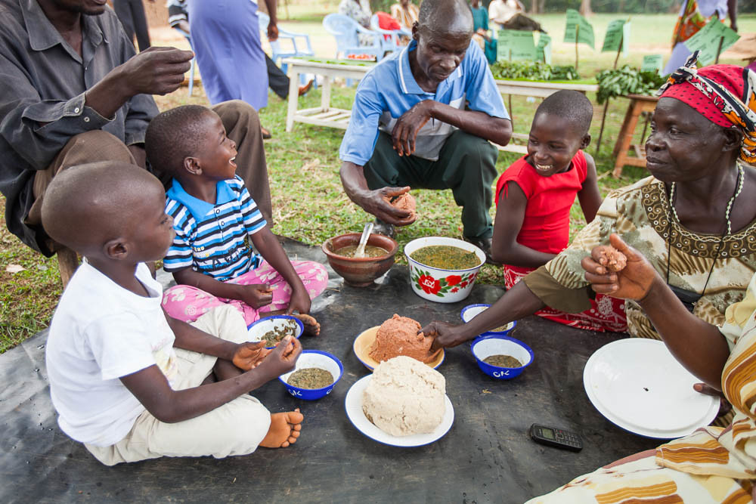
A call for action:
Isaiah 6:8: “

